Slide 1
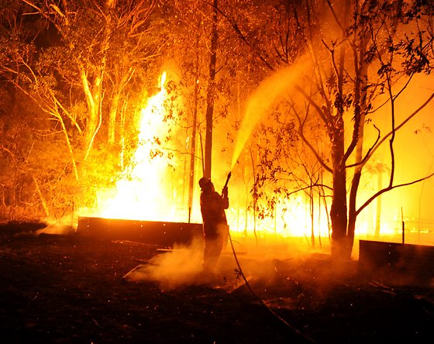
EMERGENCY MANAGEMENT
SIT-764 Team Project (A) – Project Management and Practices
Australian Bushfires
Ambulance data

Slide 2
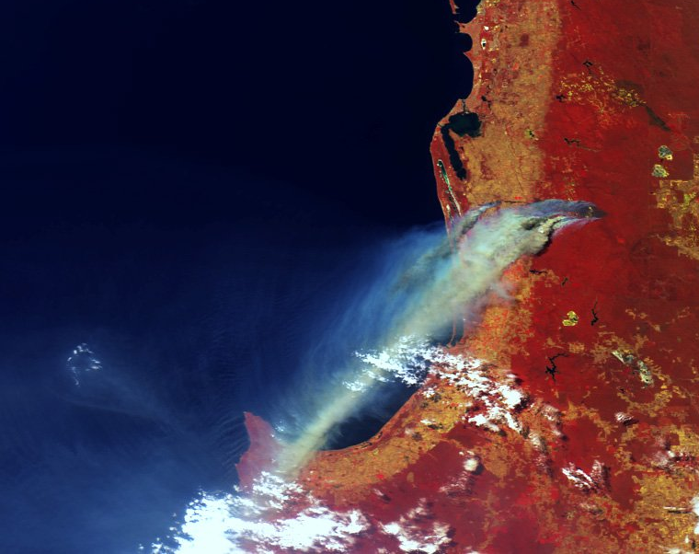
Project Overview :
The main objective of the project is to find out which areas raise huge risk for bushfires across Australia and developing a website which gives out information for all regions which have frequent bushfires.

Slide 3
Deliverables of the Overall Project :
Task | Members | Technologies
Data Sourcing | Nithin, Mohan, Nikhil Reddy, Nikita , Bala, Varsha, Vijay | Various website
Data Cleaning | Nithin, Bala Tharun | Python
Prediction Analysis | Aiswarya ,Nithin, Mohan | Python
Data visualization | Pavan, Piyush, Nikhil, Simran, Shikhar | Tableau, GIS, Python
UI | Simran ,Nikita ,Varsha, Hamza, Pavan | Atom, HTML
Main deliverables:
Finding out areas which are highly prone to bushfires
Creating a website which gives out information on bushfires across Australia and provides precautions with details of the nearest fire brigade

Slide 4
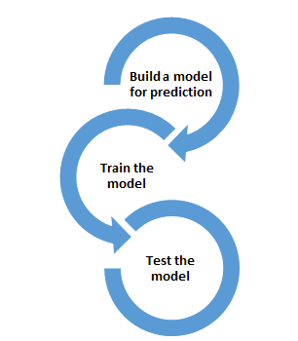


Visualization
Creating website
Data sourcing
Data cleaning
Methodology/Process

Slide 5
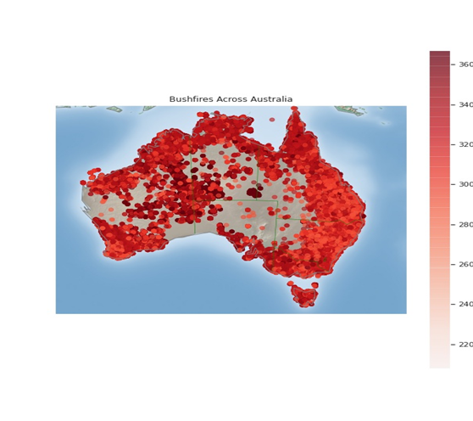
Deliverables of this iteration :
The main goal that we tried to achieve until now is to predict areas which are prone to bushfires by using different models and create a website which gives out information about bushfires
This graph shows the total number of bushfire cases across Australia. The fires have different levels of intensity which is demonstrated by the color map

Slide 7
Prediction Analysis
We have chosen a dependent variable as a state for the first model, i.e. logistic regression which is used after encoding the categorical data, the accuracy of this model is 0.86
the prediction variable have features such as probability which can provide the likelihood of bushfires for different places with under various conditions
We used multinomial Logistic Regression which has an accuracy of 0.86

Slide 8
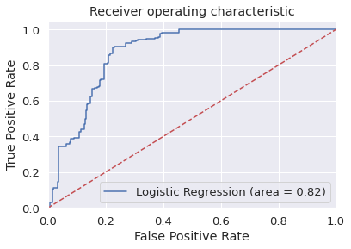
Predictions:
From the prediction analysis we can see that suburbs such as Bairnsdale which is above 38-degree Celsius had the highest probability of bushfire with 0.879
The areas with temperatures lower than 12 -degree Celsius and humidity <30% had fewer chances of bushfires with 39%
Hence proved that weather conditions have an impact on bushfires

Slide 9
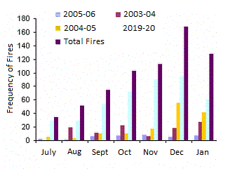
PREDICTION ANALYSIS:
A visualization of the frequency of bushfires data in the last two decades. The graph was plotted using Python.

Slide 10
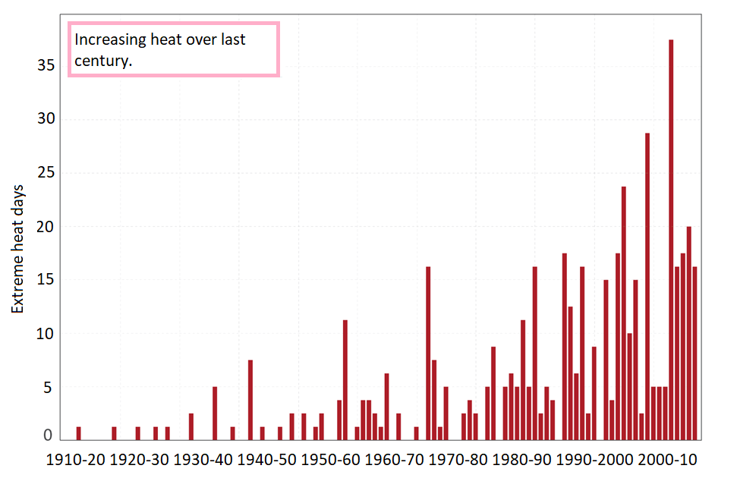
PREDICTION ANALYSIS:
Another graphical representation of the increase in extreme heat days over the last century.

Slide 11
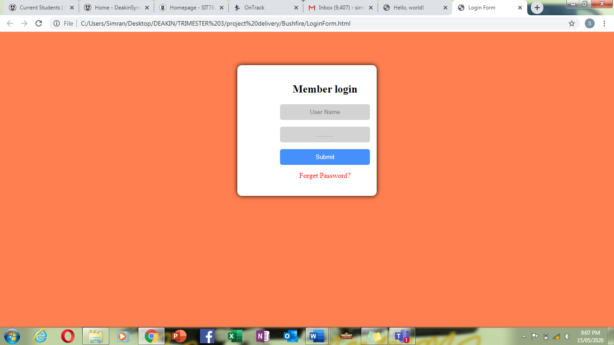
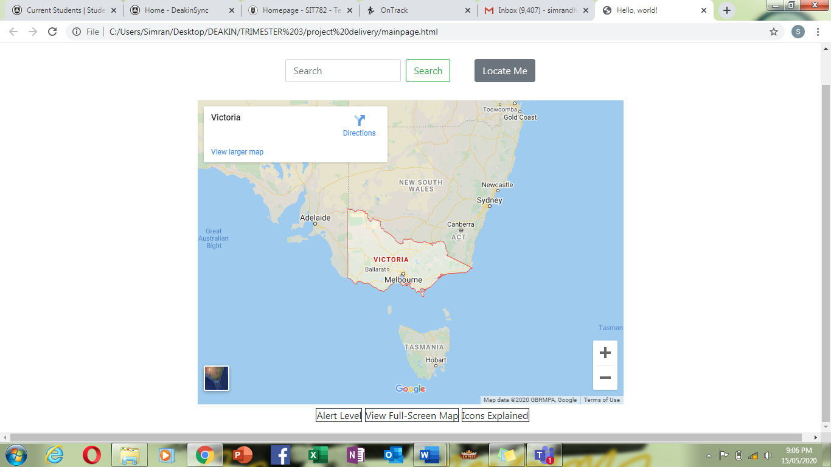
Bushfire website
The team has created an access page for general public use and a made a main page with Victoria map
To create the website we are using Atom software where we run html code

Slide 12
Tasks Completed :
The team has been successful to build a login page that is accessible to the public. Atom software was used and the scripting language was HTML.

Slide 13
Tasks Completed :
The main page of the website has been created as well with a map of Victoria representing the state we are in.

Slide 14

Challenges Faced :
Data Analysis : A new concept for some of the squad members.
User Interface : Figuring out the right software to build our web-app.
Prediction Analysis : Plotting and visualizing graphs and heatmaps to predict accurate data.

Slide 15
Team Contribution
Team Members | Major Contribution(s) | Total Hours Recorded
Mohan Kiran Bandaru | Visualization using Tableau and Python( time series for Canberra) Data sourcing for bushfire locations Documentation and it is showcased in folder "Mohan" Prediction analysis using multi linear regression model | 84
Hamza Zulfiqar | Data extraction for the bushfires, got familiar with python for my part in Iteration 2, learnt how to plot graphs and visualize data in python, UI | 70.5
Shikhar Dhyani | Data sourcing, documentation of presentations, upskilling in python, using python to create graphs for data analysis and data visualization | 61.3
Nithin Reddy Gundre | Data Sourcing, Extracting weather data, Visualisation, Documentation of UI (prototype) | 74

Slide 16
Team Contribution
Team Member | Major Contribution(s) | Hours Recorded
Pavan Vadla | Data Sourcing, Visualization of Ambulance Victoria Data, Predicting future Emergency Requirements and final documentation.
Nikita Shishupal Dighe | Mentoring and Managing, Distribution of tasks, Data Sourcing, Preparing User Interface, Planning and execution of UI, Presenting the presentation
Aiswaraya Subrahmanian | Data sourcing for bushfire and weather data. Created heat maps for data. Did reverse geocoding for the bushfire data. Created models for prediction. Found probabilities of bushfires in various places across Australia. | 106
Vijay bathini | Data souring, making presentations and Data Cleaning
Bala Tharun Reddy Shymala | Data Sourcing for Bushfire, Data Cleaning, extraction of weather data in respective with the bushfire locations | 83
Simran Rashpal Dhillon | Planning of UI design, Wireframe representation, Implementation and Execution of UI

Slide 17

Plan for the next iteration
To complete the website which is under construction and make it available to the public
An accurate map of Australia with areas which are prone to bushfires, highlighted
A website that gives out information about ongoing fires and provides with emergency hotline numbers
To handover the project to the next team progressing these ideas

